Slide 1
Raphael
A framework to create SVG graphics
Telerik Software Academy
Learning & Development
http://academy.telerik.com

Slide 2
Table of Contents
Raphael
Overview and setup
Raphael features
Creating shapes
Setting attributes
Animations

Slide 3
Raphael
Overview and setup

Slide 4
Raphael
Raphael is a JavaScript framework for working with SVG shapes
Dynamically, with JavaScript
Setting up Raphael:
Download the script from the site
Include the script into the HTML page:
Instantiate Raphael object:
Ready to go
<script src='scripts/raphael-min.js'></script>
var paper = Raphael(10, 10, 500, 500);

Slide 5
Raphael Setup
Live Demo

Slide 6
Raphael Shapes

Slide 7
Raphael Shapes
Raphael has all the basic shapes:
Rect:
var rect = paper.rect(x, y, width, height);
Circle:
var circle = paper.circle(cx, cy, radius);
Path:
var path = paper.path(points);

Slide 8
Raphael Shapes
Live Demo

Slide 9
Shape Properties

Slide 10
Shape Properties
Shapes created with Raphael have settable properties
To change fill color, stroke, etc…
var rect = paper.rect(50, 90, 180, 80);
rect.attr({
fill: 'purple',
stroke: 'blue',
'stroke-width': 10
})
.rotate(25, 170, 140);

Slide 11
Shape Properties
Shapes created with Raphael have settable properties
To change fill color, stroke, etc…
var rect = paper.rect(50, 90, 180, 80);
rect.attr({
fill: 'purple',
stroke: 'blue',
'stroke-width': 10
})
.rotate(25, 170, 140);
The attr() methods
gets an object

Slide 12
Shape Properties
Shapes created with Raphael have settable properties
To change fill color, stroke, etc…
var rect = paper.rect(50, 90, 180, 80);
rect.attr({
fill: 'purple',
stroke: 'blue',
'stroke-width': 10
})
.rotate(25, 170, 140);
The attr() methods
gets an object
Method calls can be chained

Slide 13
Shape Properties
Live Demo

Slide 14
Raphael Sets
Grouping elements together

Slide 15
Raphael Sets
Sets in Raphael allow to change the attributes of a group of elements at once
The shapes can be of any type:
Rects
Circles
Text
Images

Slide 16
Raphael Sets: Example
Change the attr of a group of elements at once
Start a set with setStart()
paper.setStart();

Slide 17
Raphael Sets: Example
Change the attr of a group of elements at once
Start a set with setStart()
paper.setStart();
Add the shapes
paper.setStart();
paper.circle(75, 85, 75);
paper.rect(160, 85, 75, 45);
paper.text(10, 200, 'This is the text');

Slide 18
Raphael Sets: Example
Change the attr of a group of elements at once
Start a set with setStart()
paper.setStart();
Add the shapes
paper.setStart();
paper.circle(75, 85, 75);
paper.rect(160, 85, 75, 45);
paper.text(10, 200, 'This is the text');
Finish the set and save it in variable
var set = setFinish();

Slide 19
Raphael Sets: Example
Change the attr of a group of elements at once
Start a set with setStart()
paper.setStart();
Add the shapes
paper.setStart();
paper.circle(75, 85, 75);
paper.rect(160, 85, 75, 45);
paper.text(10, 200, 'This is the text');
Finish the set and save it in variable
var set = setFinish();
Set properties
set.attr({ … });

Slide 20
Raphael Sets
Live Demo

Slide 21
Raphael for SVG
http://academy.telerik.com

Slide 22


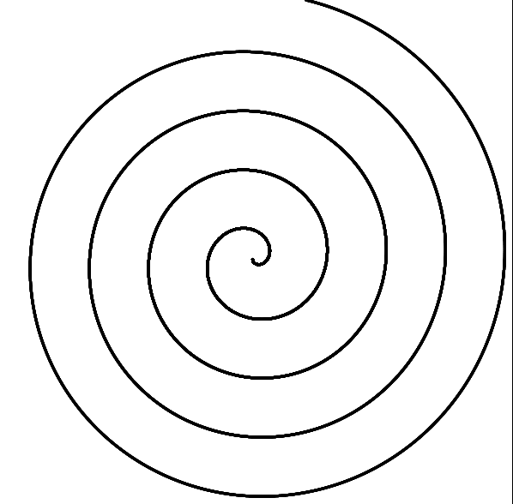
Homework
Create the following images using Raphael:
Create a spiral with Raphael
*Hint: use many circles with radius 1px

